Slide 1

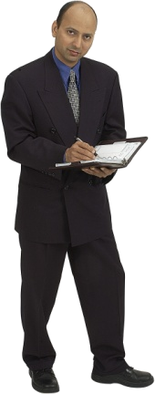

Recording and Running a Test
NHS Automation Team

Slide 2
Recording Modes
Recording and Running a test
Different recording modes in QTP are
Standard or Context-Sensitive Record mode
Analog Record mode
Low level Record mode

Slide 3
Analog mode
Recording and Running a test
Analog Recording—enables you to record the exact mouse and keyboard operations you perform in relation to either the screen or the application window. In this recording mode, Quick Test records and tracks every movement of the mouse as you drag the mouse around a screen or window.
This mode is useful for recording operations that cannot be recorded at the level of an object, for example, recording a signature produced by dragging the mouse.

Slide 4
Low-Level recording
Recording and Running a test
Low-Level Recording—enables you to record on any object in your application, whether or not Quick Test recognizes the specific object or the specific operation.
This mode records at the object level and records all run-time objects as Window or Win Object test objects. Use low-level recording for recording in an environment or on an object not recognized by Quick Test. You can also use low-level recording if the exact coordinates of the object are important for your test or component.

Slide 5
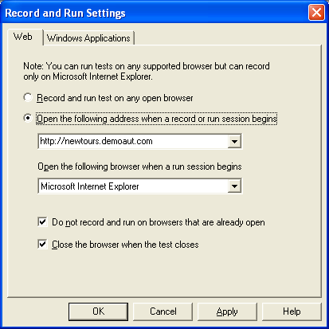
Recording a test
Recording and Running a test
Choose Automation > Record from the menu or click the Record button or Press F3 to start recording a script. The Record and Run Settings dialog box opens.

Slide 6
Recording a test (Contd…)
Recording and Running a test
In the Web tab, select the option ‘Open the following address when a record or run session begins’.
Choose a browser from the Type list and confirm that the URL in the Address box is the correct URL.
Confirm that Close the browser when the test closes and Do not record and run on browsers that are already open checkboxes are selected.

Slide 7
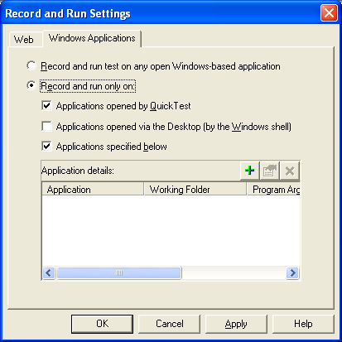
Recording a test (Contd…)
Recording and Running a test
In the Windows Applications tab, confirm that Applications opened by QuickTest and Applications specified below are selected after selecting the ‘Record and run only on’ option, and that there are no applications listed

Slide 8
Recording a test (Contd…)
Recording and Running a test
Click OK.
QuickTest begins recording, and browser opens to the Mercury
Tours Web site. In QuickTest, click Stop on the Testing toolbar to
stop the recording process.

Slide 9
Analyzing the Test in the Keyword View
Recording and Running a test
QuickTest generates steps in the Keyword View representing each operation you performed in the Web browser or Windows Application.
The columns in the Keyword View show different information for each step,
as follows:
  Item: Displays the item for the step (test object, utility object, function call, or statement) in a hierarchical icon-based tree.
  Operation: The operation to be performed on the item, example, Click or Select.
  Value: The argument values for the selected operation
  Assignment: The assignment of a value to or from a variable
  Comment: A free text edit box for any information you want to add regarding the step. These are also displayed as inline comments in the Expert View.
  Documentation: Auto-documentation of what the step does, in an easy-to-understand sentence, for example, Click the "find" image.

Slide 10
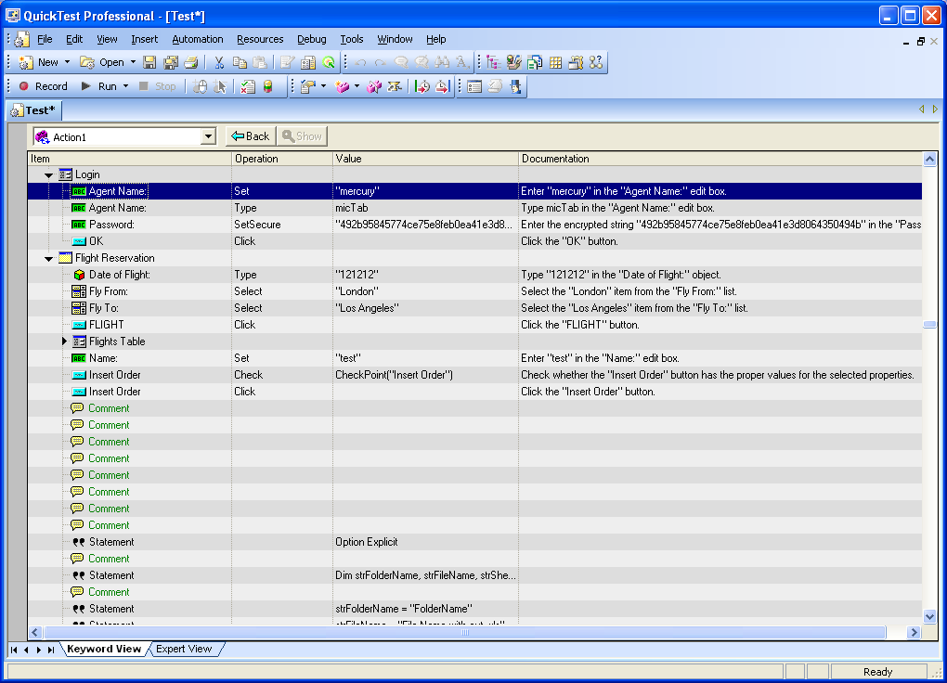
Analyzing the Test in the Keyword View (Contd…)
Recording and Running a test

Slide 11
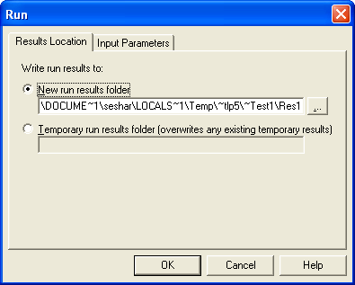
Running a test
Recording and Running a test
Click Run or Press F5 or choose Automation > Run from the menu. The Run dialog box opens.
If you want the results to be shared in a specific folder, Select New run
results folder. Accept the default results folder name or Specify the
Folder path where you want store the results.
Alternatively, you can select the Temporary run results folder. Then,
the results are stored in a temporary folder and get overwritten during
each test run.
Click OK to close the Run
dialog box and
start the execution.

Slide 12
Summary of the Topics Covered
Recording and Running a test
Recording Modes
Recording a test
Analyzing the Test in the Keyword View
Running a test
Questions?

Slide 13

Thank You

